Slide 1
SAROBIN SILVIYA
Final Project

Slide 2
PATIENT-SPECIFIC HEART DISEASE PROGRESSION SIMULATION USING VAE(Variational Encoder)

Slide 3


AGENDA
PROBLEM STATEMENT
PROJECT OVERVIEW
WHO ARE THE END USERS ?
YOUR SOLUTION AND ITS VALUE PROPOSITION
THE WOW IN YOUR SOLUTION
MODELLING
RESULTS
3/21/2024 Annual Review

Slide 4

PROBLEM STATEMENT
Heart disease is a leading cause of death worldwide. Early detection and understanding of the disease progression can significantly improve patient outcomes. The goal of this project is to develop a machine learning model that can simulate the progression of heart disease in a specific patient based on their unique health parameters.
You are provided with a dataset (heart.csv) containing health parameters of patients, some of whom have heart disease. Your task is to build a Variational Autoencoder (VAE), a type of generative model, to learn the underlying distribution of the data. Once trained, the VAE should be able to generate synthetic patient data that resembles the training data. The synthetic data can be used to simulate the progression of heart disease in a patient. This

Slide 5

PROJECT OVERVIEW
The primary objective of this project is to simulate the progression of heart disease in patients. This simulation can aid in understanding the disease progression and potentially improve patient outcomes.
Data Preprocessing: The first step involves loading and preprocessing the dataset. The dataset, ‘heart.csv’, contains health parameters of patients, some of whom have heart disease. The target column is dropped, and the remaining features are normalized to ensure optimal performance of the machine learning model.
Expected Outcome: The expected outcome of this project is a trained model that can generate synthetic patient data. This synthetic data can be used to simulate the progression of heart disease in a patient, providing valuable insights into the disease progression and potentially informing treatment strategies.
Applications: This project has potential applications in healthcare research, particularly in understanding the progression of heart disease and developing new treatment strategies. It can also be used in privacy-preserving data sharing, where the synthetic data can be shared instead of the real patient data, thus preserving patient privacy.

Slide 6

WHO ARE THE END USERS?
The end users for this project could be a variety of individuals and organizations involved in healthcare and medical researches like :
Healthcare Researchers: Researchers working on heart disease could use this model to generate synthetic data for their studies, especially when real patient data is not available or cannot be used due to privacy concerns.
Medical Professionals: Doctors and other medical professionals could use this model to better understand the progression of heart disease in their patients and potentially inform treatment strategies.
Healthcare Institutions: Hospitals and other healthcare institutions could use this model to simulate the progression of heart disease in their patient population, aiding in resource planning and management.
Pharmaceutical Companies: These companies could use this model in the development and testing of new drugs for heart disease.
Data Scientists in Healthcare: Data scientists working in the healthcare industry could use this model as a basis for developing more complex models or for integrating with other data sources.
Educational Institutions: Universities and other educational institutions could use this model for teaching and research purposes.

Slide 7

YOUR SOLUTION AND ITS VALUE PROPOSITION
Understanding Disease Progression: By simulating the progression of heart disease, medical professionals and researchers can gain valuable insights into how the disease might progress in different patients, potentially leading to more personalized and effective treatment strategies.
Data Privacy: The ability to generate synthetic patient data can help preserve patient privacy. Instead of using real patient data, which can often be sensitive and subject to strict privacy regulations, researchers can use synthetic data that maintains the statistical properties of the original data but doesn’t contain any personally identifiable information.
Data Augmentation: In situations where the available patient data is limited, the ability to generate synthetic data can be very useful. The synthetic data can augment the original data, providing more robust and diverse datasets for training other machine learning models.
Education and Research: The synthetic data and the insights gained from the disease progression simulation can be valuable resources for educational and research purposes.

Slide 8

THE WOW IN YOUR SOLUTION
The “wow” factor in this solution lies in its innovative application of Variational Autoencoders (VAEs), a type of generative model, to simulate the progression of heart disease in patients. This approach not only enhances our understanding of the disease but also opens up new possibilities in personalized healthcare. By generating synthetic patient data based on unique health parameters, the model can potentially inform more personalized and effective treatment strategies, leading to improved patient outcomes. Furthermore, the ability to generate synthetic data helps preserve patient privacy, a critical aspect in healthcare research. Instead of using sensitive real patient data, researchers can work with synthetic data that maintains the statistical properties of the original data but doesn’t contain any personally identifiable information. Lastly, the synthetic data can augment existing datasets, especially in situations where available patient data is limited, leading to more robust and diverse datasets for training other machine learning models. This novel application of VAEs demonstrates the transformative potential of generative AI models in healthcare research.
3/21/2024 Annual Review
8

Slide 9
MODELLING
Data Collection: Gather a dataset that includes a wide range of potential risk factors. This could include demographic information, physiological factors, and lifestyle factors.
Data Preprocessing: The dataset, ‘heart.csv’, is loaded and preprocessed. The target column is dropped, and the remaining features are normalized.
Model Building: A Variational Autoencoder (VAE), a type of generative model, is built. The VAE consists of an encoder and a decoder. The encoder takes the input data and encodes it into a latent space representation. The decoder takes the latent representation and decodes it back into the original input space.
Model Training: The VAE is trained on the preprocessed data. The training process involves minimizing the reconstruction loss and the KL divergence loss.
Data Generation: After training, the VAE is used to generate synthetic patient data that resembles the training data.
9

Slide 10
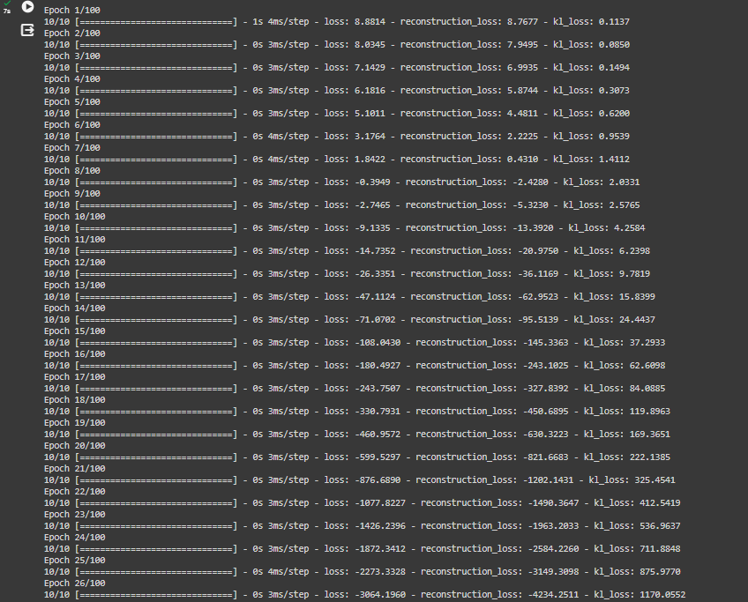
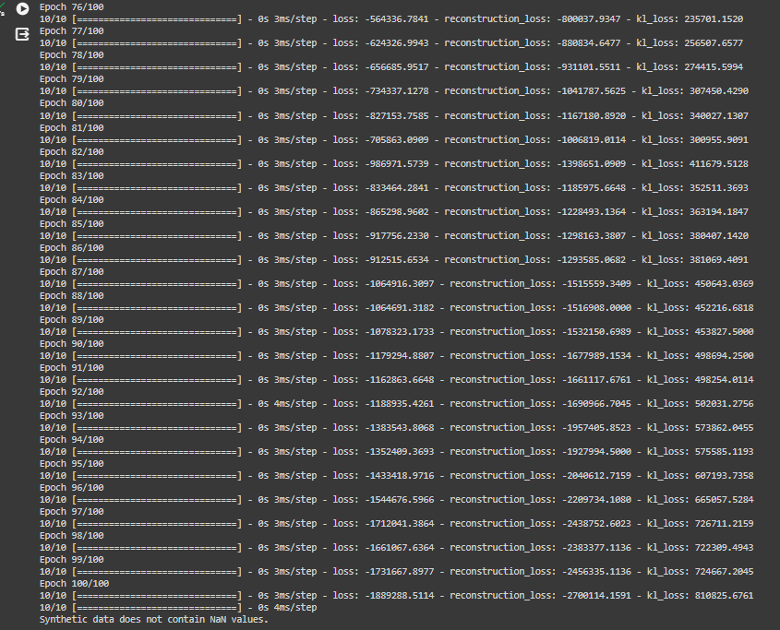
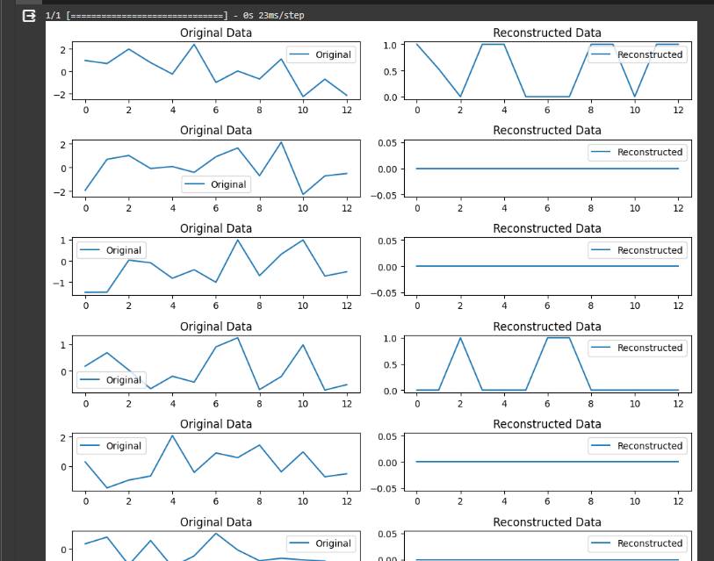
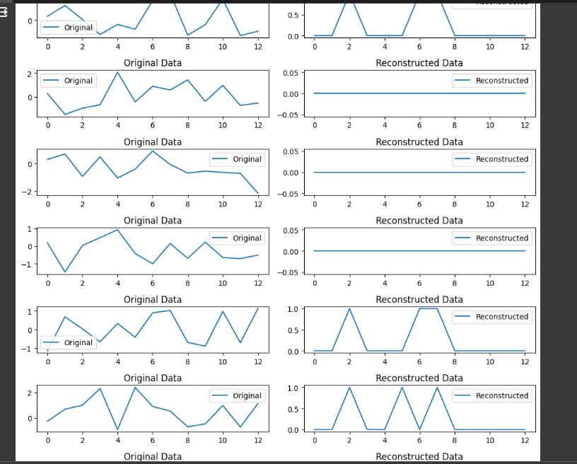
RESULTS
The project successfully used a Variational Autoencoder to simulate heart disease progression, generating synthetic data that closely resembled the original patient data.
The results reveal the effectiveness of our model. The reconstructed data closely mirrors the original, demonstrating the model’s ability to learn and replicate complex patterns. This success opens up new possibilities for predictive analysis in heart disease, making our solution a potential game-changer in healthcare technology.
10

